Slide 1



Time-series Modeling, Analysis, Interface, and Insight from Entomological Electropenetrography
Team: Mehrezat Abbas (TL), Devanshi Guglani, Milo Knell, Zachary Traul, Lillian Vernooy
Advisor: Prof. Gabriel Hope
Liaisons: Dr. Elaine Backus (USDA), Dr. Anastasia Cooper (Auburn), Dr. Kathryn Reif (Auburn)
Notes:
Mehrezat
A title slide that includes:
the title of the project (which might be different from the title in the original Clinic Description, if the goals of the project have evolved)
the names of all team members, with the Fall TL labeled
the name of the faculty advisor
the names of the liaison(s)

Slide 2

Raise your hand if…
Notes:
Devanshi

Slide 3
Raise your hand if…
you’ve encountered a bug before
Notes:
Devanshi

Slide 4
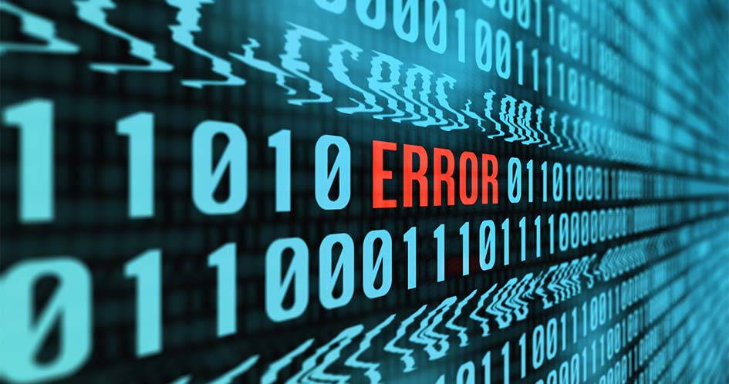
Let’s talk about bugs!
Notes:
Devanshi

Slide 5
Let’s talk about bugs!
Not this kind!
Notes:
Devanshi

Slide 6
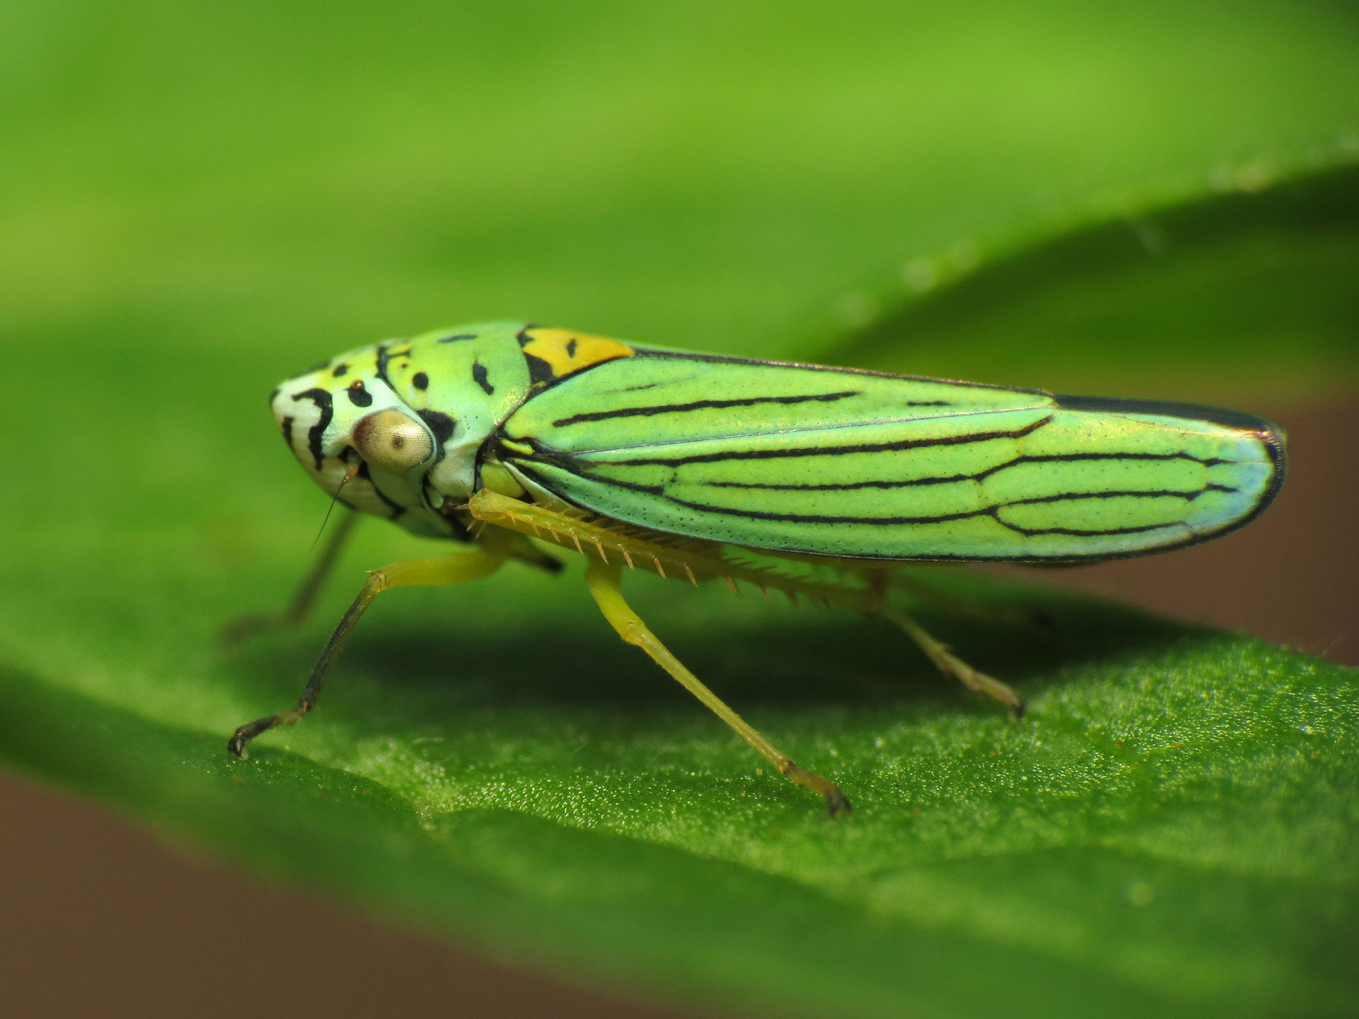
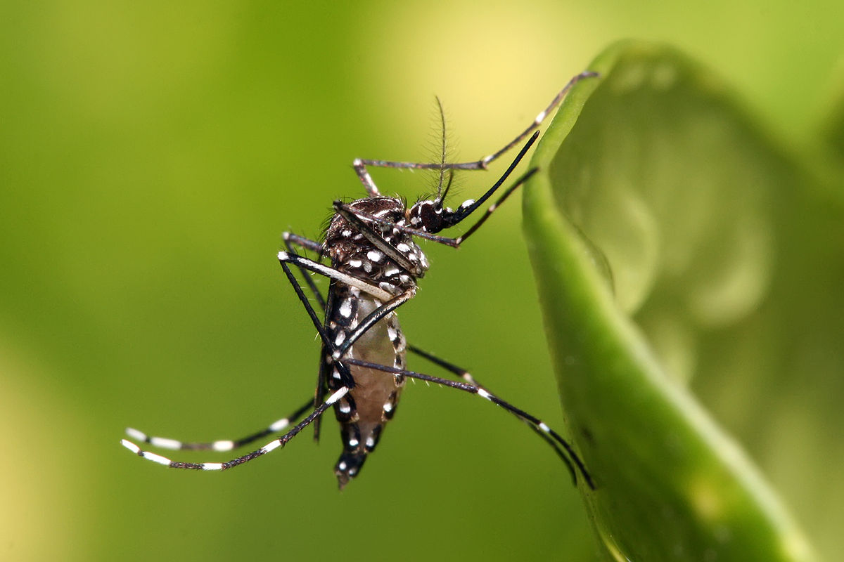
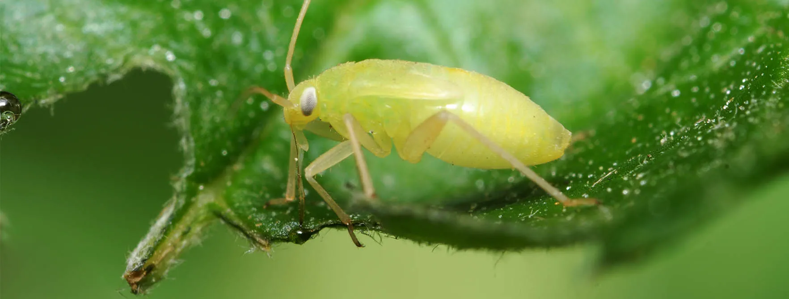
The real kind:
mosquitoes
sharpshooters
aphids
Notes:
Devanshi

Slide 7
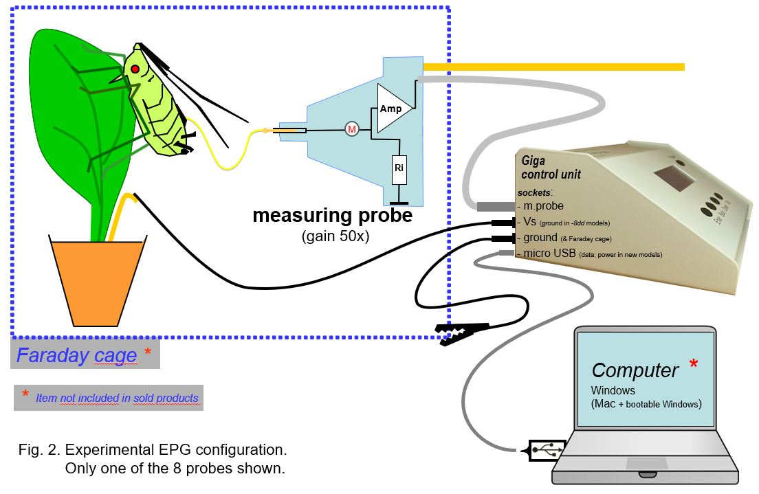
EPG
Notes:
Devanshi

Slide 8
EPG
Electrical Penetration Graph
Notes:
Devanshi

Slide 9
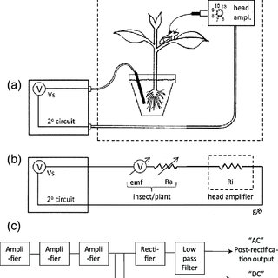
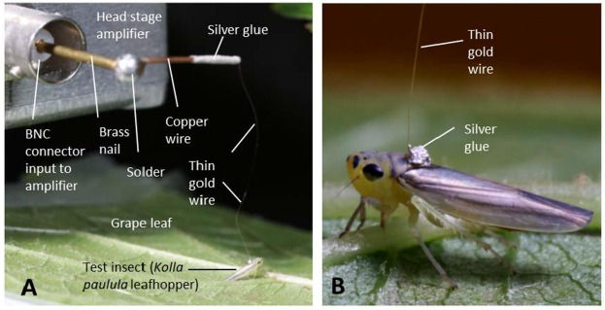
EPG
Notes:
Devanshi

Slide 10
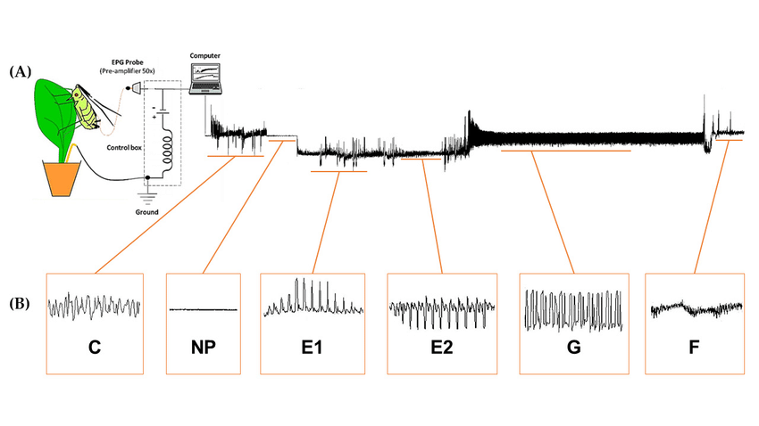
EPG
Notes:
Devanshi

Slide 11
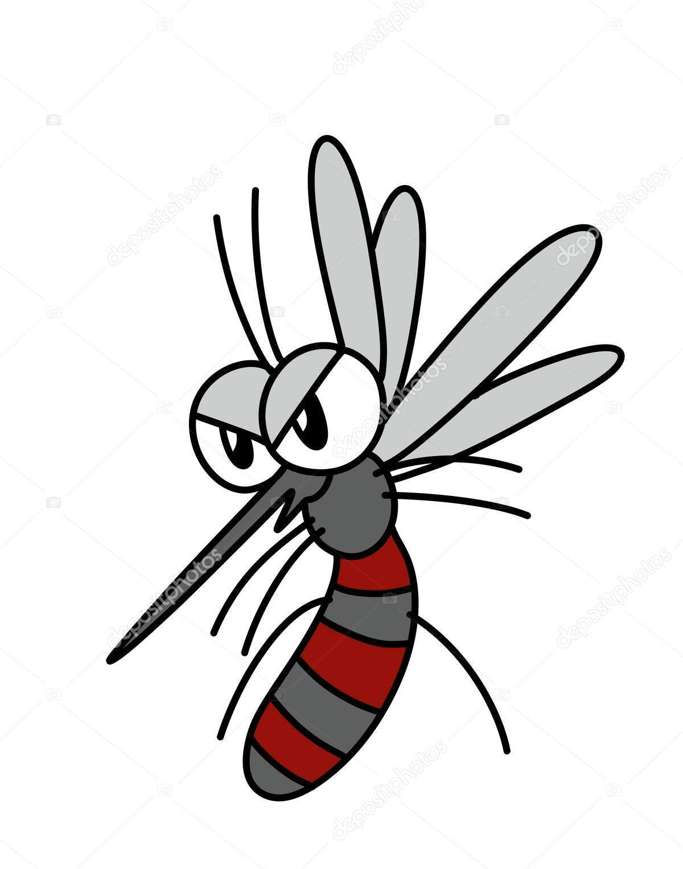
Who cares? (Here’s why you should!)
200,000 years
108 billion humans
52 billion killed by mosquitos
Our Deadliest Predator [source]
Notes:
Devanshi
The deadliest killer in human history might not be guns or bombs, cancer or car accidents. It's a pesky insect that most of us don't think twice about: the mosquito. Over the course of 200,000 years, 108 billion people have lived on Earth. And nearly half, 52 billion, have been killed by mosquitoes.

Slide 12
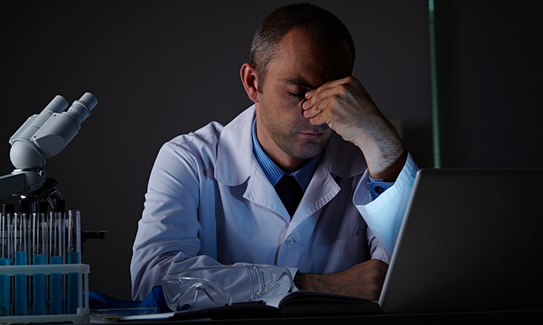
How can we help?
Waveform labelling is presently done manually
This menial task takes ages, subject to inaccuracies
Putting a bottleneck on research, delaying advancement
Notes:
Devanshi - why our sponsors care
Despite the magnitude of this issue, waveforms presently need to be manually labeled and that takes a while and we’d like to be able to do that much faster since it puts a bottleneck on research

Slide 13
Problem Statement
We seek to automate electropenetrography annotation in order to accelerate entomological research on harmful pests.
Notes:
Mehrezat - bring it all together in summary
A slide with the title "Problem Statement" whose sole content is a single sentence stating the overall goals of this project.
SOW Problem Statement:
Manually labeling feeding behaviors on EPG waveforms is an unfortunately lengthy process for entomologists, including our liaisons at the AU and the USDA. As labeling waveforms takes away time that they could be spending on lab work, manuscript preparation, and other tasks, it also puts a bottleneck on research throughput. The importance of removing this bottleneck has risen in recent years due to changes in arthropod ranges from climate change that threaten agriculture in both the United States and worldwide. As EPG is a powerful tool for studying how parasitic arthropods interact with their hosts, improving the speed at which EPG data can be interpreted will be critical for understanding and combating threats to agriculture from existing and newly introduced pests.
Due to our funding specifications as laid out by the National Bio and Agro-Defense Facility and National Science Foundation, our project’s focus will be on blood-sucking arthropods such as mosquitoes and ticks, which threaten both humans and livestock. Our aim is to use machine learning techniques to develop software that can largely automate the process of labeling EPG waveforms. As our sponsor’s entomologists lack the technical expertise to do so themselves, they are seeking the assistance of Harvey Mudd College’s Clinic team for development of this tool. In pursuit of this, our Clinic team aims to develop a machine learning model capable of labeling feeding phases and behaviors of bloodsucking arthropods in EPG waveforms and to create a software interface for its use by entomologists. If successful, our tool will improve EPG research output and help to modernize EPG for combating the current and future challenges faced by
agriculture.

Slide 14
Objectives
Define Performance Metrics
Develop the Model
How do we measure our model’s practical benefit to entomologists?
Design and train a predictive model for waveform recognition
Develop an Interface
Stretch Goal
Researchers need to be able to upload data and receive labeled files
Build a tool that allows researchers to train new models for different species

Slide 15
Objectives
Define a performance metric
Really hard to know how useful a given model will be to a researcher. While something simple like label accuracy is vaguely helpful, knowing where and why the model makes mistakes is key. We need to develop some basic metric (or set of metrics) to describe the performance of one of our models that has some alignment to how useful it will be to entomologists.
Develop a machine-learning model that automatically labels data
As we’ve explain thus far, a big step is to actually design the predictive model that we will use to label the data automatically.
Develop an interface for this model for use by entomologists
We want to design an easy-to-use interface for our audience, entomologists, who do not have a computer science background. They should easily be able to view the predictions of the model overlaid on the actual voltage data, potentially highlighting interesting areas such as low-confidence regions.
Stretch goal
Additional tool which can re-train the model on either a new arthropod species or new data collected under different circumstances (i.e new machine)
Notes:
Mehrezat
A more detailed explanation of the project objectives, in brief.
Explain your project's criterion for success
You can choose to mention stretch goals, if any, but don't spend a lot of time on them.
SOW Objectives
Define a metric for performance of our machine learning algorithm so
we can compare its performance to the standards of our liaisons and
the researchers who will use this tool.
• Create a machine-learning tool that automatically labels arthropod
(in particular, mosquitoes and other bloodsucking arthropods) EPG
voltage data according to the waveform.
• Stretch Goal: we hope to provide a secondary tool that can provide
extra desired functionality:
– Given labeled data for other arthropod species (e.g. aphid), re-
train the machine learning algorithm to label novel data for the
new arthropod species.
– Given new data for the same arthropod species but on potentially
different machinery or collected under different circumstances,
8
Roadmap Objectives
re-train the machine learning algorithm to label data under these
different circumstances.
• This tool, including potential secondary tools for re-training under
different circumstances, should be usable by an audience that does
not have a computer science or machine learning background. This
includes, but should not be limited to:
– Labeling data with the model should take a reasonable amount
of time on a desktop computer. In terms of reasonable, we mean
that it should run for inference (making predictions) on the order
of minutes, not hours or days. Re-training might potentially take
longer but can be run in the background and is only a one-time
cost for a new species or setup.
– The interface and model should be compatible with standard
desktop operating systems, in particular Mac and Windows.
– The interface and model should be a stand-alone application. In
particular, it should not rely on the software being produced con-
currently with this project by our sponsor’s Engineering Clinic
team.
– The interface and model should accept data in the form of comma
separated value and WINDAQ files as these are the two most
common formats in which waveform data has historically been
recorded.
– The interface should be easy to use by entomologists, particularly
entomologists at Auburn/USDA. While evaluation of this objec-
tive is somewhat difficult, we will know when we have achieved
it by feedback from our liaisons.
– The interface and model should provide the user a metric of
its confidence in each classification and flag uncertain areas for
review which can then be classified by the user. This will require
that our interface has the ability to display waveforms and labels
and edit them.
– The interface should have the ability to export labels and times-
tamps in a format compatible with existing tools used by our
sponsors for further analysis

Slide 16
Criterion for Success
It’s tricky!
Previous models have hovered around an 80% accuracy rate, which we have already achieved!
Accuracy isn’t everything…
Success = producing a model that is intuitively usable by scientists
In terms of model performance, our project is based on continuous improvement and balance of accuracy between data regions
Notes:
Mehrezat

Slide 17
Criterion for Success
Accuracy isn’t everything…
Success = producing a model that is intuitively usable by scientists
In terms of model performance, our project is based on continuous improvement and balance of accuracy between data regions
Knowing what success looks like in all these areas is tricky, since we can always have a better model or a more intuitive interface.
By working closely with our sponsors, showing them prediction plots and summary statistics we can move towards a strong predictive model given the constrained data, compute, and time we are working with. We can iterate both the predictive model and interface based on what the entomologists themselves find most useful.
Broadly, we think it will be a success if we have a predictive model that does reasonably well on all regions in the data and makes our sponsors happy, paired with an interface that our sponsors find intuitive and easy to use.
Notes:
Mehrezat

Slide 18
Context
What is electropenetography
Picture of device
Picture of example waveform
What it is used for: learning about pests (mosquitos ew)
Notes:
Devanshi: Context
CNN discussion: Milo
Decision Trees: Zach
Enough relevant details about the sponsor that the audience will understand why they'd care about your project
The sponsor as a whole and/or the team you're working with.
Enough technical background that the audience can understand what you are trying to accomplish.
Everyone in the audience should be able to grasp what you’re proposing to do and why; it’s okay if the “how” is obvious only to folks with relevant domain expertise. For example, you don't need to explain how neural networks work; but if you are proposing them as a major component of your upcoming work, folks should be able to understand why you think they're a good choice and what they'll do to help your client.

Slide 19
Why our sponsors care about this project
Something about how waveforms have to be manually labeled and that takes a while and we’d like to be able to do that much faster since it puts a bottleneck on research
Notes:
Devanshi

Slide 20
Context (Previous Work)
We aren’t the first people to try to do this
Notes:
Zach

Slide 21
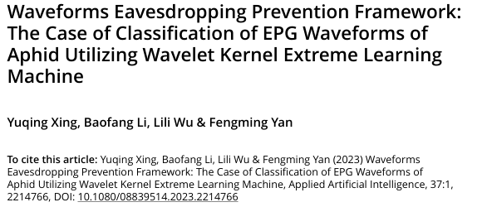
Context (Previous Work)
We aren’t the first people to try to do this
Notes:
Zach

Slide 22
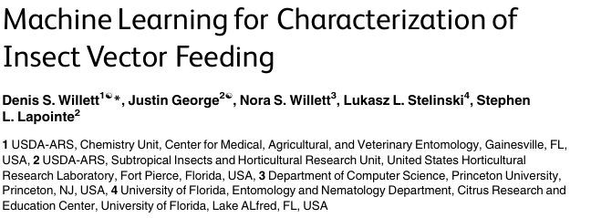
Context (Previous Work)
We aren’t the first people to try to do this
Notes:
Zach

Slide 23
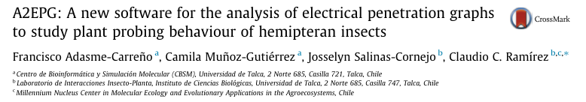
Context (Previous Work)
We aren’t the first people to try to do this
Notes:
Zach

Slide 24
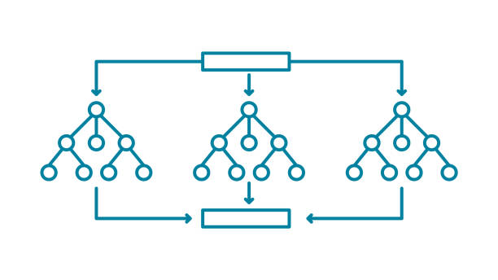
Context (Previous Work)
How have people already attempted to solve the problem?
Cut recording into chunks
Calculate per-chunk statistics
Use *machine learning* to predict category
Random forests

Slide 25
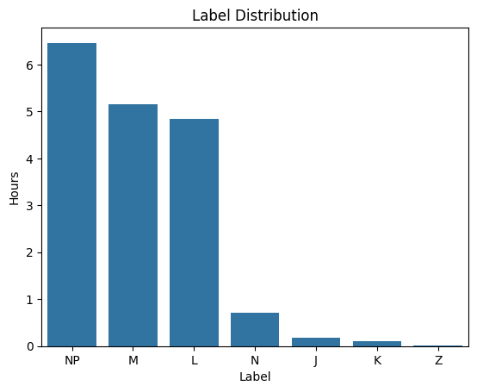
Context (Previous Work)
So what’s wrong with those methods?
Aphid-specific
Fixed features
Ignores context
Poorly handles unbalanced data (like ours)

Slide 26
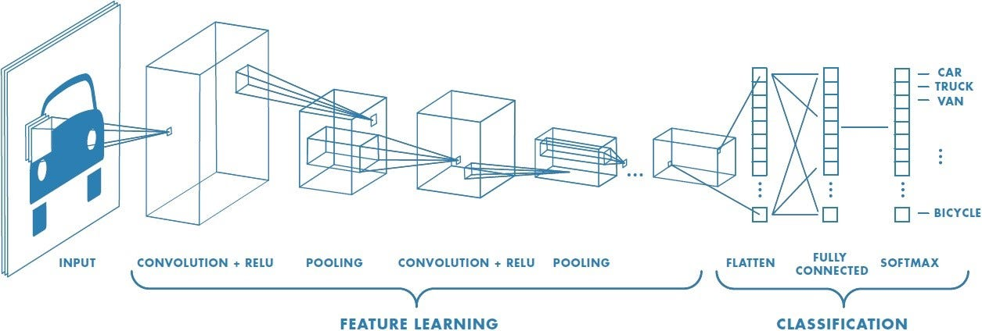
Context (Deep Learning)
Local pattern recognition
Well studied
Efficient
Good for automated feature extraction
Notes:
Milo
: CNNs are good at identifying short-term dependencies in time series data. With some additional complexity (U-net, adding an RNN, dilated stack) we can model longer-term dependencies better was well.
: there exists a lot of research and infrastructure surrounding 1d-CNN based time series modeling that we can leverage to quickly start building complex systems.
: CNNs can process large datasets very quickly, and the number of layers grows logarithmically with the amount of data we want to feed in.
Automatically extracts relevant features, this is very important if we want a domain-adaptable model that can be retrained and does not rely on specific feature engineering for a given arthropod species.

Slide 27
Timeline
November: Decision of machine learning approach
December: Initial prototype of model and interface
Test prototype during site visit
February: Improved prototype of model and interface
April: Final prototype of model and interface
Notes:
TODO: slide is just saying the same thing three times…
Lillian
A brief summary of your plan for the rest of the year e.g.,
Ideas for attacking the problem
Evidence (e.g., a schedule or milestones) demonstrating that the plan is achievable by May.
SOW Plan
Decision of Machine Learning Approach October 2024
Fall Presentation October 22 or 29, 2024
Initial Prototype of Identification Model December 2024
Initial Prototype of Interface December 2024
Midyear Update December 6, 2024
Second Prototype of Identification Model February 2025
Feature Freeze April 11, 2025
Final Identification Model April 2025
Final Interface April 2025
Code Freeze April 25, 2025
Poster April 29, 2025
Final Report May 9, 2025
Project Handoff May 9, 2025

Slide 28
Plan
October: Decision of Machine Learning Approach
December: Initial Prototype of Model, Interface
February: Second Prototype of Model, Interface
April: Final Prototype of Model, Interface
Notes:
Devanshi

Slide 29
Deliverables
Machine learning model
Generate labels for a recording
Stretch goal: tool to retrain model for new data sets
Interface
Allow user to upload file and view time-domain signal
Generate and overlay labels on the visualized signal using model
Notes:
Lillian
A slide with the title "Deliverables", whose content is the list of deliverables for this project.

Slide 30
Ethics
Sponsors have little computer science expertise
Must convey system limitations
If our software is sold, potential for scientific damage becomes greater
Notes:
Lillian
Sponsors aren’t tech-savvy and are perhaps over-trusting of our model. It will be important that we present its capabilities accurately and make sure they have a level of caution when using it
If our model generates inaccurate labels and these are blindly trusted, could be scientifically damaging
If successful our software may be sold as part of a commercial product, potential for inaccurate results to damage science become greater
Working with proprietary data, care should be taken to ensure data is not released
—--
An "Ethics" slide that raises one important ethical issue that your team needs to keep in mind while working on this project; see the instructions below.
The Ethics Slide
Your talk must discuss one important ethical issue that your team will need to keep in mind while working on this project.
In particular, this should be something your team has the agency to impact as part of your project. In other words, try to identify an ethical issue that your team can do (or has done) something about by adjusting the methods or outcomes of your project.
In choosing, you might think about the following (non-exhaustive!) list of questions:
If your project works with or stores data that is not fully public, what are the consequences if the data were to become fully public? What are your legal and moral responsibilities in handling this data?
If your project works with data sources (for example, as input to an AI model), how was the data sourced? Are there any considerations to take into account about how the data was acquired? Are there any potential omissions from the data set, and how would using the data set with these omissions affect people?
If your project requires a lot of computation (e.g., to build a model, or run a simulation), what are the energy and/or environmental considerations for the project?
What responsibility do you have to make sure the project can continue after you stop working on it and hand it over? What are the resources (not just equipment, but also support personnel) that your project will require long-term? What are the consequences of requiring those resources, in terms of sustainability of the project?
If your project is likely to affect people further downstream (users, customers, employees, etc.), what responsibilities do you have to them (in terms of the content of your work, the quality of your work, or how you document and communicate limitations of your work)? Is your work likely to affect everyone equally, or primarily benefit/disadvantage specific groups?
You can also consult ethical requirements of relevant professional societies, such as the ACM Code of Ethics and Professional Conduct and the AMS Policy Statement on Ethical Guidelines.
Many (or most) projects will have multiple important ethical aspects! We encourage you to keep them all in mind as you do the work, but for such a short talk, there's really only time to give one the full attention it deserves.

Slide 31
Acknowledgements
Funding
USDA (58-2034-3-445)
USDA (58-3022-4-034)
NSF (DBI - 2304787)
Notes:
Whoever is last (Lillian)
Optionally, an "Acknowledgements" slide to thank people who provided significant help despite not being formally part of the project, e.g.,
colleagues of your liaisons who provided useful background or advice
faculty members (other the advisor) who made technical suggestions
college staff members who went above and beyond in arranging logistics
anyone else who significantly contributed but who is not listed on the title slide

Slide 32
Thank You
Please clap now

Slide 33
Questions!
Please write down/share any suggestions for ML approaches that you might have!
Notes:
Mehrezat
A final slide with the title "Questions?" that contains one or more helpful prompts for discussion, e.g., any or all of
relevant keywords
recap of important diagrams
the project statement
aspects of the project where you particularly want feedback
questions that your team would like to crowdsource
...

Slide 34
